Slide 1
Powering Tomorrow for a Sustainable Future
A Comprehensive Social Media Toolkit for National Propane Day
Wednesday, March 20, 2024

Slide 2
"Propane is the missing link between the realities of energy today and the hope for the energy of tomorrow." Shannon Watt, CPA President and CEO
National Propane Day Goals
To bring national attention to the many benefits of propane as a safe, affordable, and cleaner energy source essential to decarbonizing the national energy system.
Educate policymakers about propane and why it must be reflected in government policy as an essential energy source for Canada’s clean energy future.
Highlight and honour the people at the core of the propane industry, encompassing everyone involved including industry partners, customers, friends, and the broader energy community.
propane.ca

Slide 3
Canadian Propane Decarbonization Roadmap
Coinciding with our National Propane Day is the exciting launch of the Canadian Propane Decarbonization Roadmap, our industry’s roadmap to produce renewable propane. This first-of-its-kind Canadian study provides quantitative evidence of how propane can play a role in lowering emissions in alignment with climate targets.
propane.ca

Slide 4
National Propane Day
Key Messaging
Propane is an affordable, accessible, and low-carbon Canadian energy source with unmatched versatility. It is used daily by millions of Canadians, from heating homes, drying crops, and transporting children to school to powering forklifts.
Propane provides energy choice. It is an ideal and reliable source of primary or backup energy for rural, remote, and Indigenous communities.
Propane creates energy resiliency for Canadians – it continues to work even when the electric grid fails.
Propane is on the path to zero emissions with the onset of biopropane.
propane.ca

Slide 5
Save the Date
March 20, 2024
Join the Celebration!
Celebrate National Propane Day
Share the Energy: Spread the word about National Propane Day and its significance in Canada's energy landscape.
Connect Virtually: Utilize social media platforms, email, and messaging apps to share messages and join the national conversation.
Ignite Creativity: Inspire your company teams to demonstrate their creativity by sharing fun and innovative ideas for celebrating propane, including hosting an event at your company office or retail location.
Share Your Story: Showcase your pride in the propane industry and its positive impact on communities nationwide by sharing your propane story.
propane.ca

Slide 6
Official Hashtags and Social Media Platforms
Connect, engage, and celebrate with us on March 20, 2024!
Let's make National Propane Day a trend across social media by using the official hashtags. Your participation makes a difference in spreading the energy for all!
Engage with our content and encourage your network to do the same.
Official Hashtags
#PropaneDay: The key hashtag for all National Propane Day content.
#EnergyForAll: Emphasize the inclusive nature of propane as an energy source.
Social Media Platforms
Follow Us: Stay connected with the Canadian Propane Association on social media.
Twitter: @PropaneCanada
LinkedIn: Canadian Propane Association
Facebook: /CanadianPropaneAssociation
Instagram : instagram.com/canadianpropaneassociation/
propane.ca

Slide 7
Suggested Messages
Connect, engage, and celebrate with us on March 20, 2024!
Message 1:
Celebrate National Propane Day on March 20, 2024! 🎉 Let's acknowledge the vital role of propane in creating a cleaner and resilient energy future for Canada. Share your propane stories and spread the warmth! 🔥 #EnergyForAll #PropaneDay
Message 2:
This National Propane Day, let’s celebrate the power of propane as a reliable, affordable source of energy that keeps us warm, especially in challenging climate conditions. Share a photo or video showcasing how propane powers your daily life! 🏡 🚗 #PropaneDay #CleanEnergy
Message 3:
Did you know propane is the missing link to a low-carbon future? Let's celebrate National Propane Day on March 20, 2024, by raising awareness about its benefits and sustainability. Share this post and let's make #PropaneDay trend! 🌿💡#EnergyTransition
propane.ca

Slide 8
Customizable Graphics
Connect, engage, and celebrate with us on March 20, 2024!
Text Modification:
Create a personalized message by modifying the text on slides 9 and 10.
Adjust the wording to align with your organization's voice and style.
Image Replacement:
Click left to replace the image with one that resonates with your National Propane Day celebration.
Register it as a JPEG or PNG for a visually appealing and unique touch.
Download Your Template:
Save your customized template by selecting "save as" > file format (JPEG or PNG) > 'save' > click 'just this one.'
NOTE: After modifying a post, ‘regroup’ items on the slide by holding down the shift button and selecting all the items then right-click to select ‘Group’.
propane.ca

Slide 9
l
Happy National Propane Day!
#EnergyForAll

Slide 10
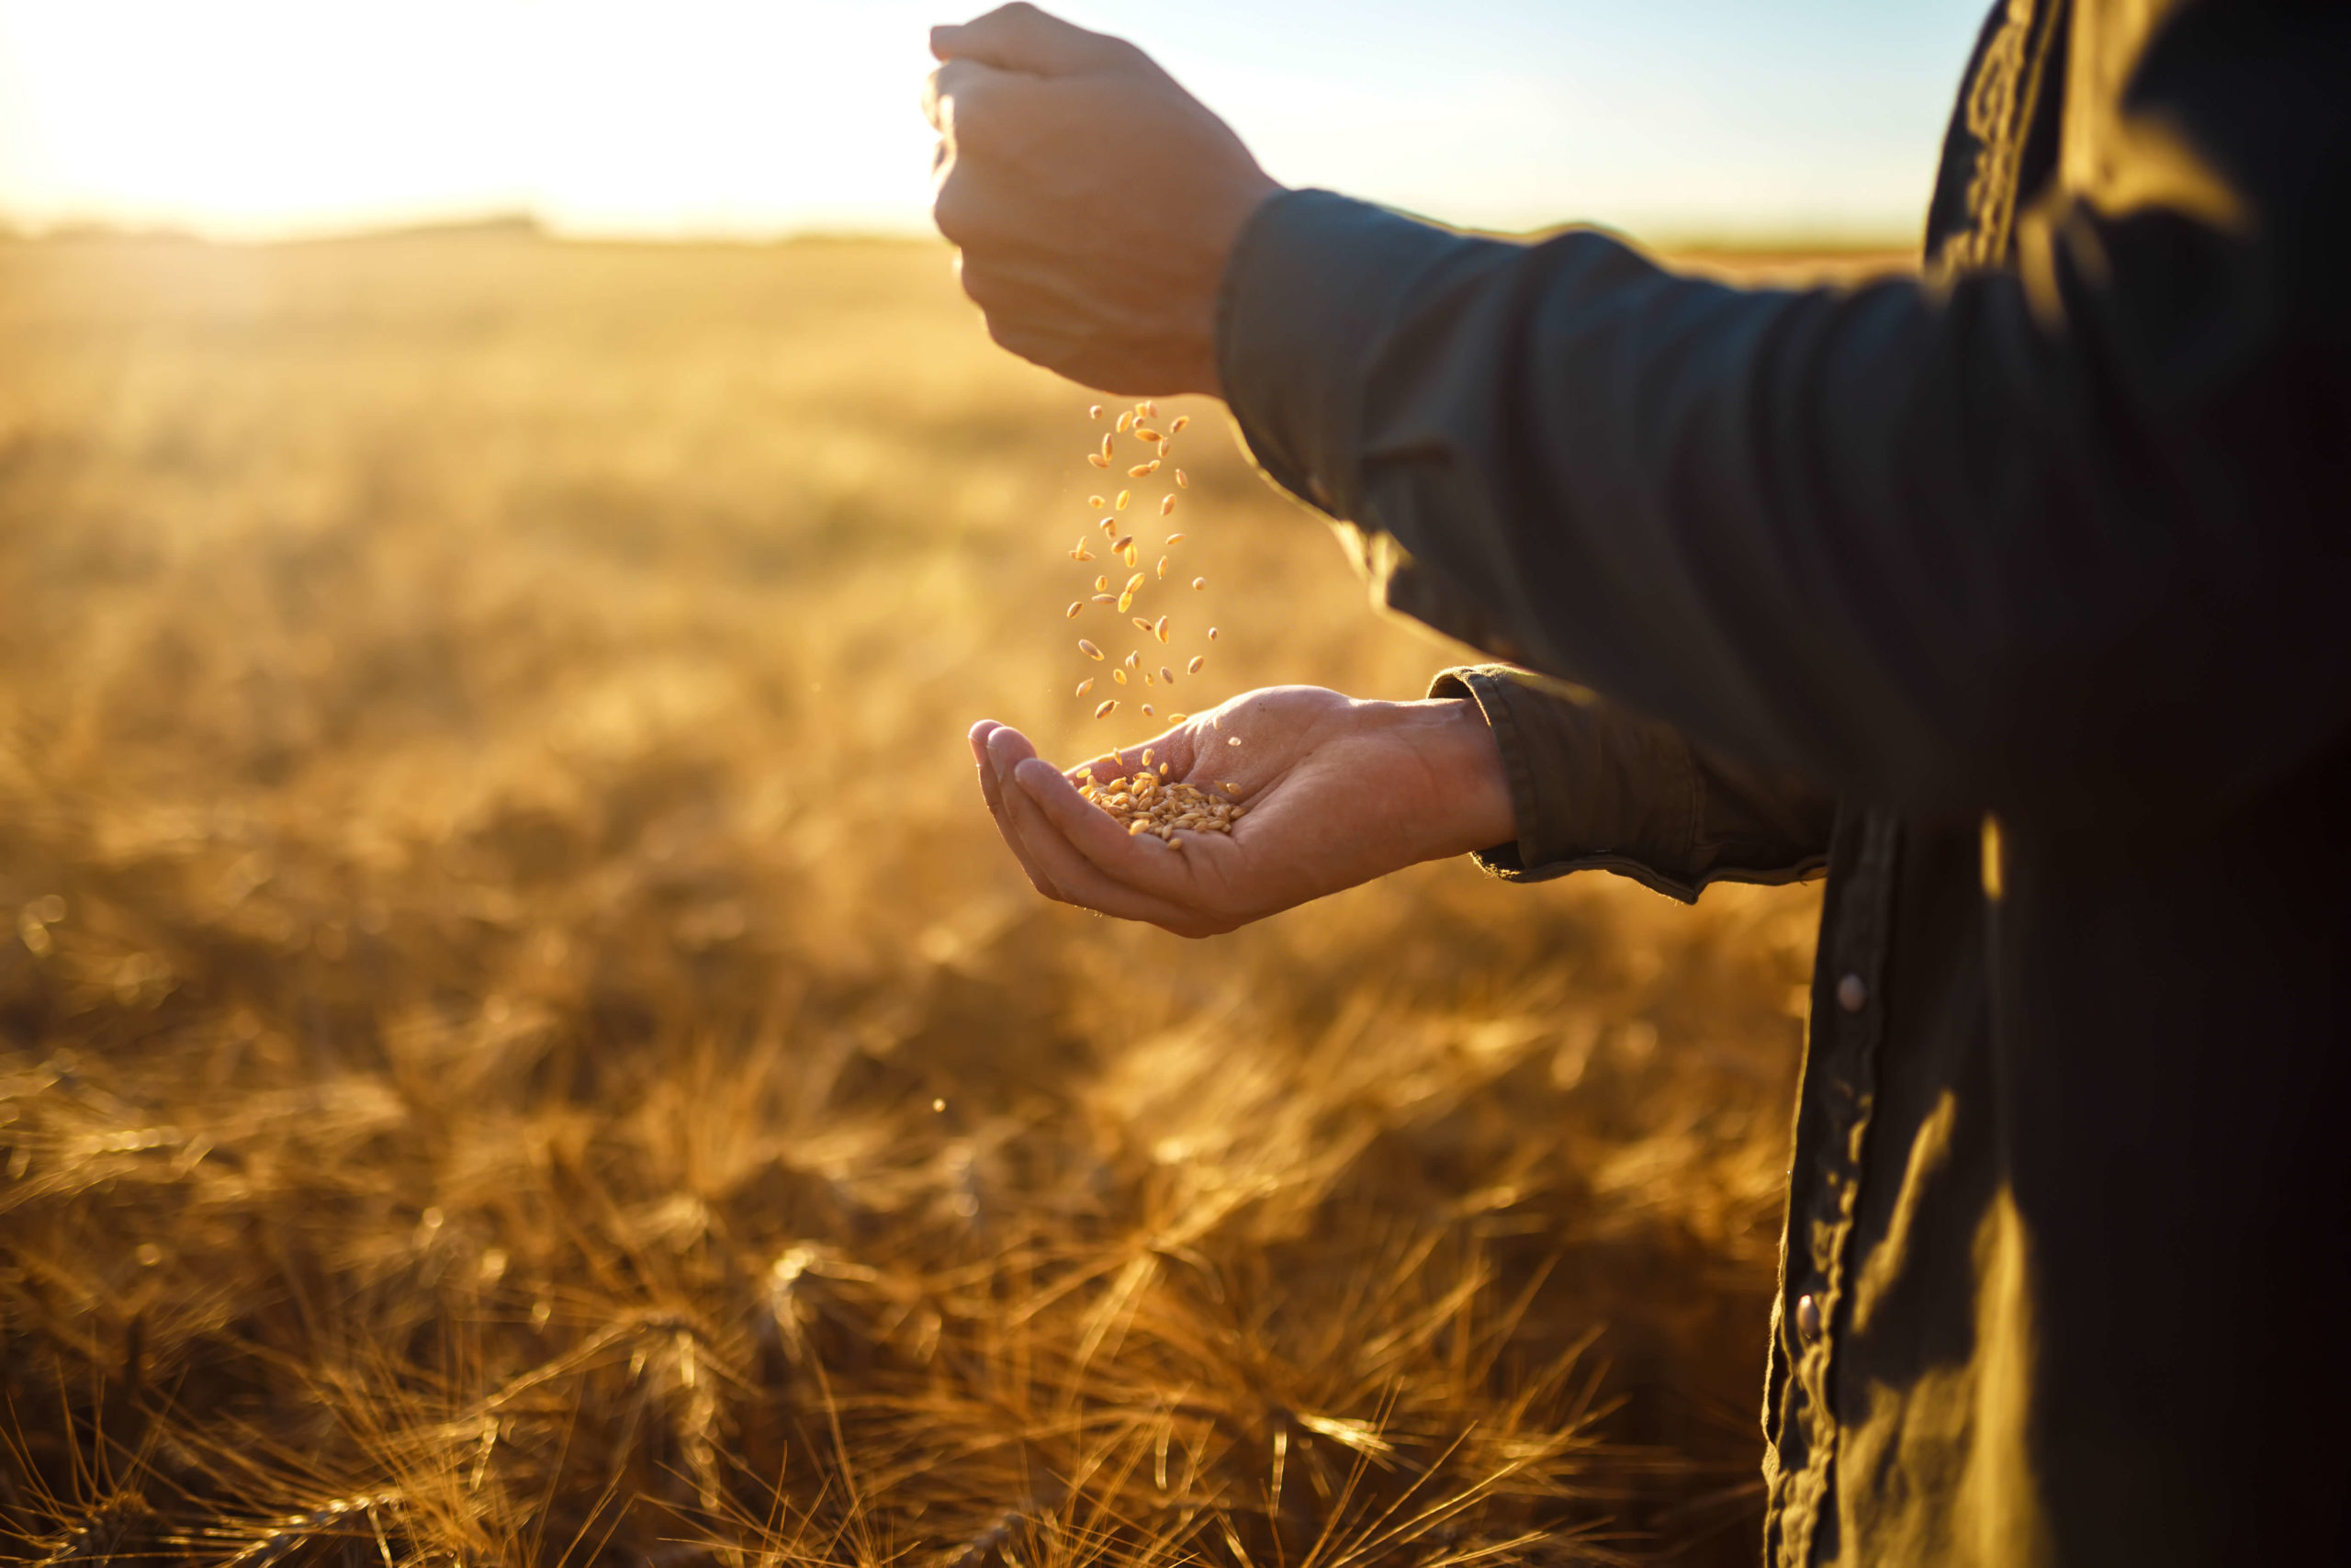
Happy National Propane Day!
#EnergyForAll

Slide 11
Happy National Propane Day!
#EnergyForAll

Slide 12
Powering Tomorrow for a Sustainable Future

Slide 13
l
#EnergyForAll

Slide 14
Logos
Connect, engage, and celebrate with us on March 20, 2024!
propane.ca

Slide 15
Logos/Ad
Connect, engage, and celebrate with us on March 20, 2024!
l
propane.ca

Slide 16
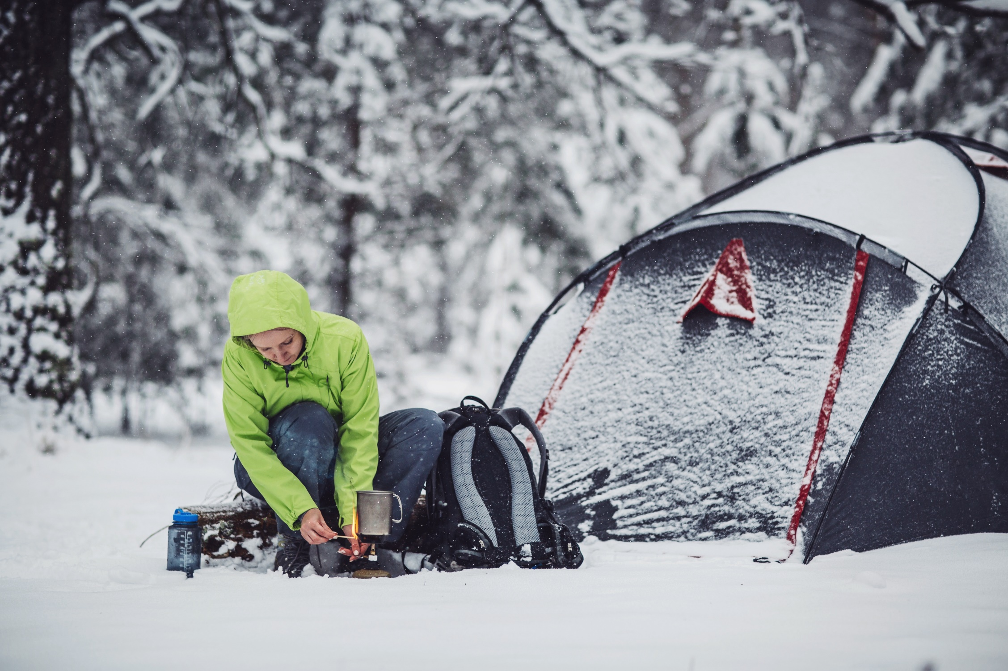

Slide 17
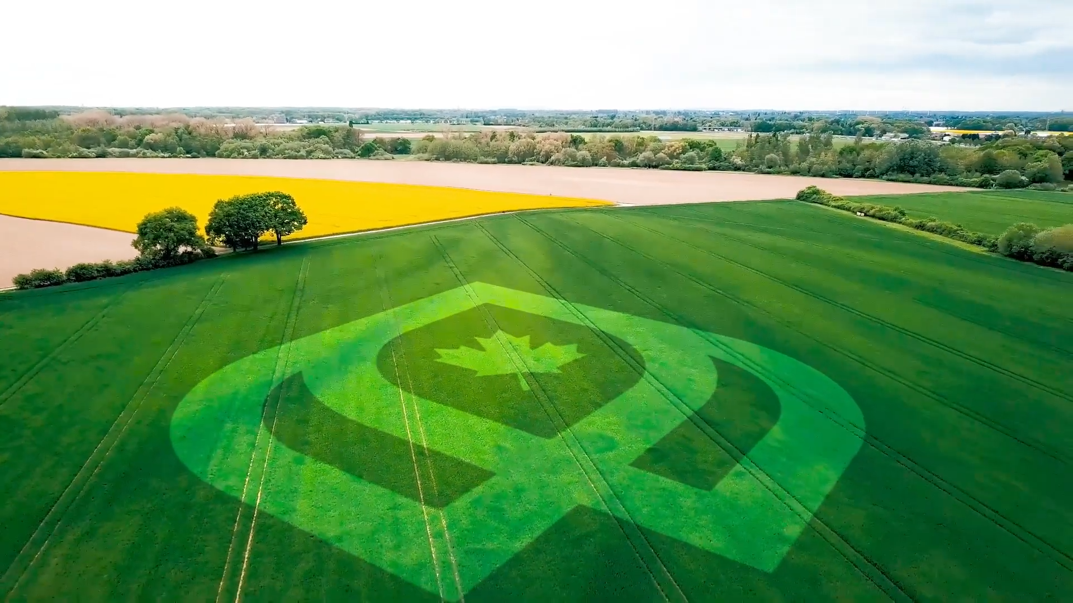

Slide 18
Learn More About National Propane Day
Connect, engage, and celebrate with us on March 20, 2024!
Looking for more information or inspiration?
Dedicated Webpage: For detailed information about National Propane Day, visit our dedicated webpage at https://propane.ca/national-propane-day/
Why Use Propane?: Discover the benefits of using propane and its positive impact on the environment at https://propane.ca/environment
Propane Across Canada: Explore where propane is used and its significance across the country at https://propane.ca/member-area/regional-profiles/
The Propane Story: Dive into the fascinating journey of propane as an essential energy source at https://propane.ca/about-propane/
propane.ca

Slide 19
Thank You for Celebrating
National Propane Day with Us!

